Slide 1
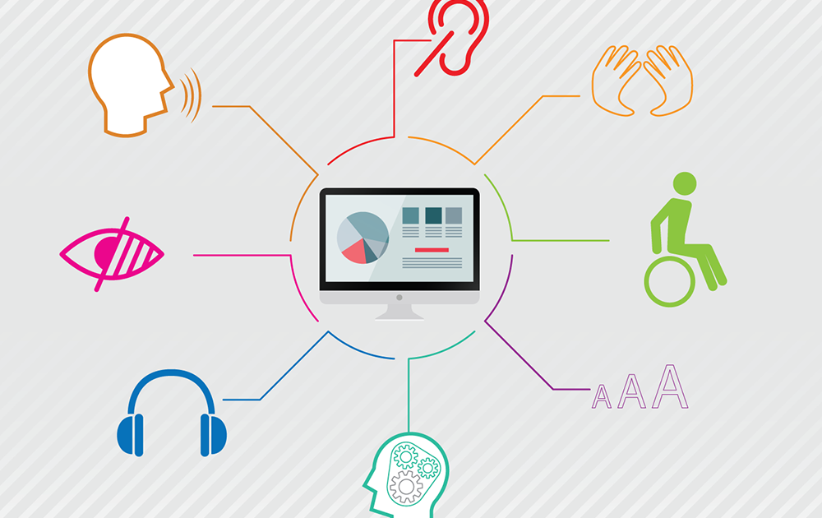
Web Accessibility
By Collin Tuck

Slide 2
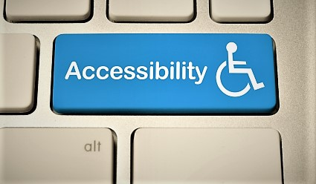
About
Accessibility focuses on how a disabled person accesses or benefits from a website, system or application.
Accessibility presents information through multiple sensory channels, usually through means of sight and sound.
They offer additional site navigation beyond the basic point and click user interface.

Slide 3

Alternative Text for Images
Providing alternative text for images is a common form of web accessibility.
This allows people who are blind to review audio files of the image using a screen reader.

Slide 4
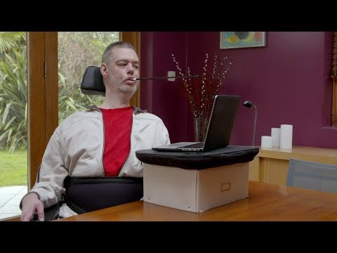
User Interface & Navigation
To those who are unable to use a mouse effectively, keyboard compatibility is essential.
This allows all necessary navigation and user interface to be operated from the keyboard.
Includes links, buttons, forms, etc.

Slide 5
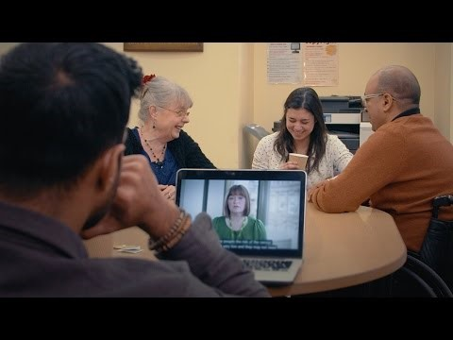
Transcripts
Transcripts provide users with hearing disabilities a means to view the contents of a web page.
They often come in the form of text files, or as captioning on a media file.

Slide 6
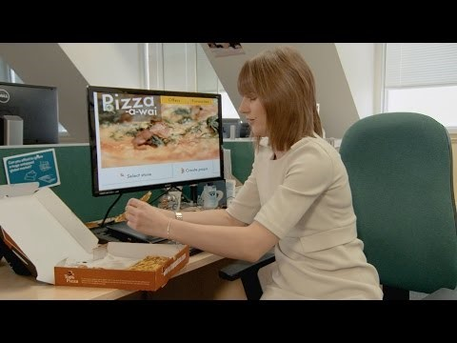
Clear Layout & Design
Clear layout and design allows users to navigate through the site without becoming confused by its organization and structure.
Content is easy to locate and identify.
Sections of the page are distinguishable from each other.
Related content is grouped together.
Design and user functionality is consistent throughout the site.

Slide 7
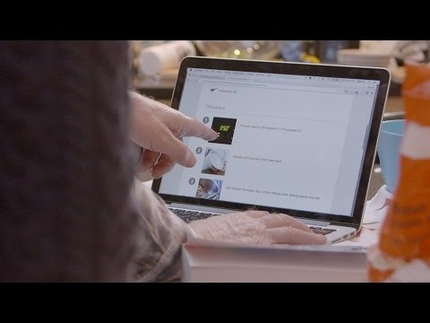
Understandable Content
For the content of a web page to be easily understandable, users must be able to follow along with the structure and information displayed on the page.
This is usually done by keeping sentences simple and to the point, as well as providing explanations to what is being displayed.
Illustrations are provided for images.
Content has a consistent design and layout throughout.

Slide 8
Sources
https://www.w3.org/standards/webdesign/accessibility
https://www.youtube.com/channel/UCU6ljj3m1fglIPjSjs2DpRA

